Slide 1
Weether
November 17, 2017

Slide 2
Purpose Objectives
To share the process of creating Weether and demo the MVP
Introduce the team and their roles
Explain the end to end process
Define the technology
Outline the application design
Describe challenges faced
Demonstrate and provide overview of service

Slide 3
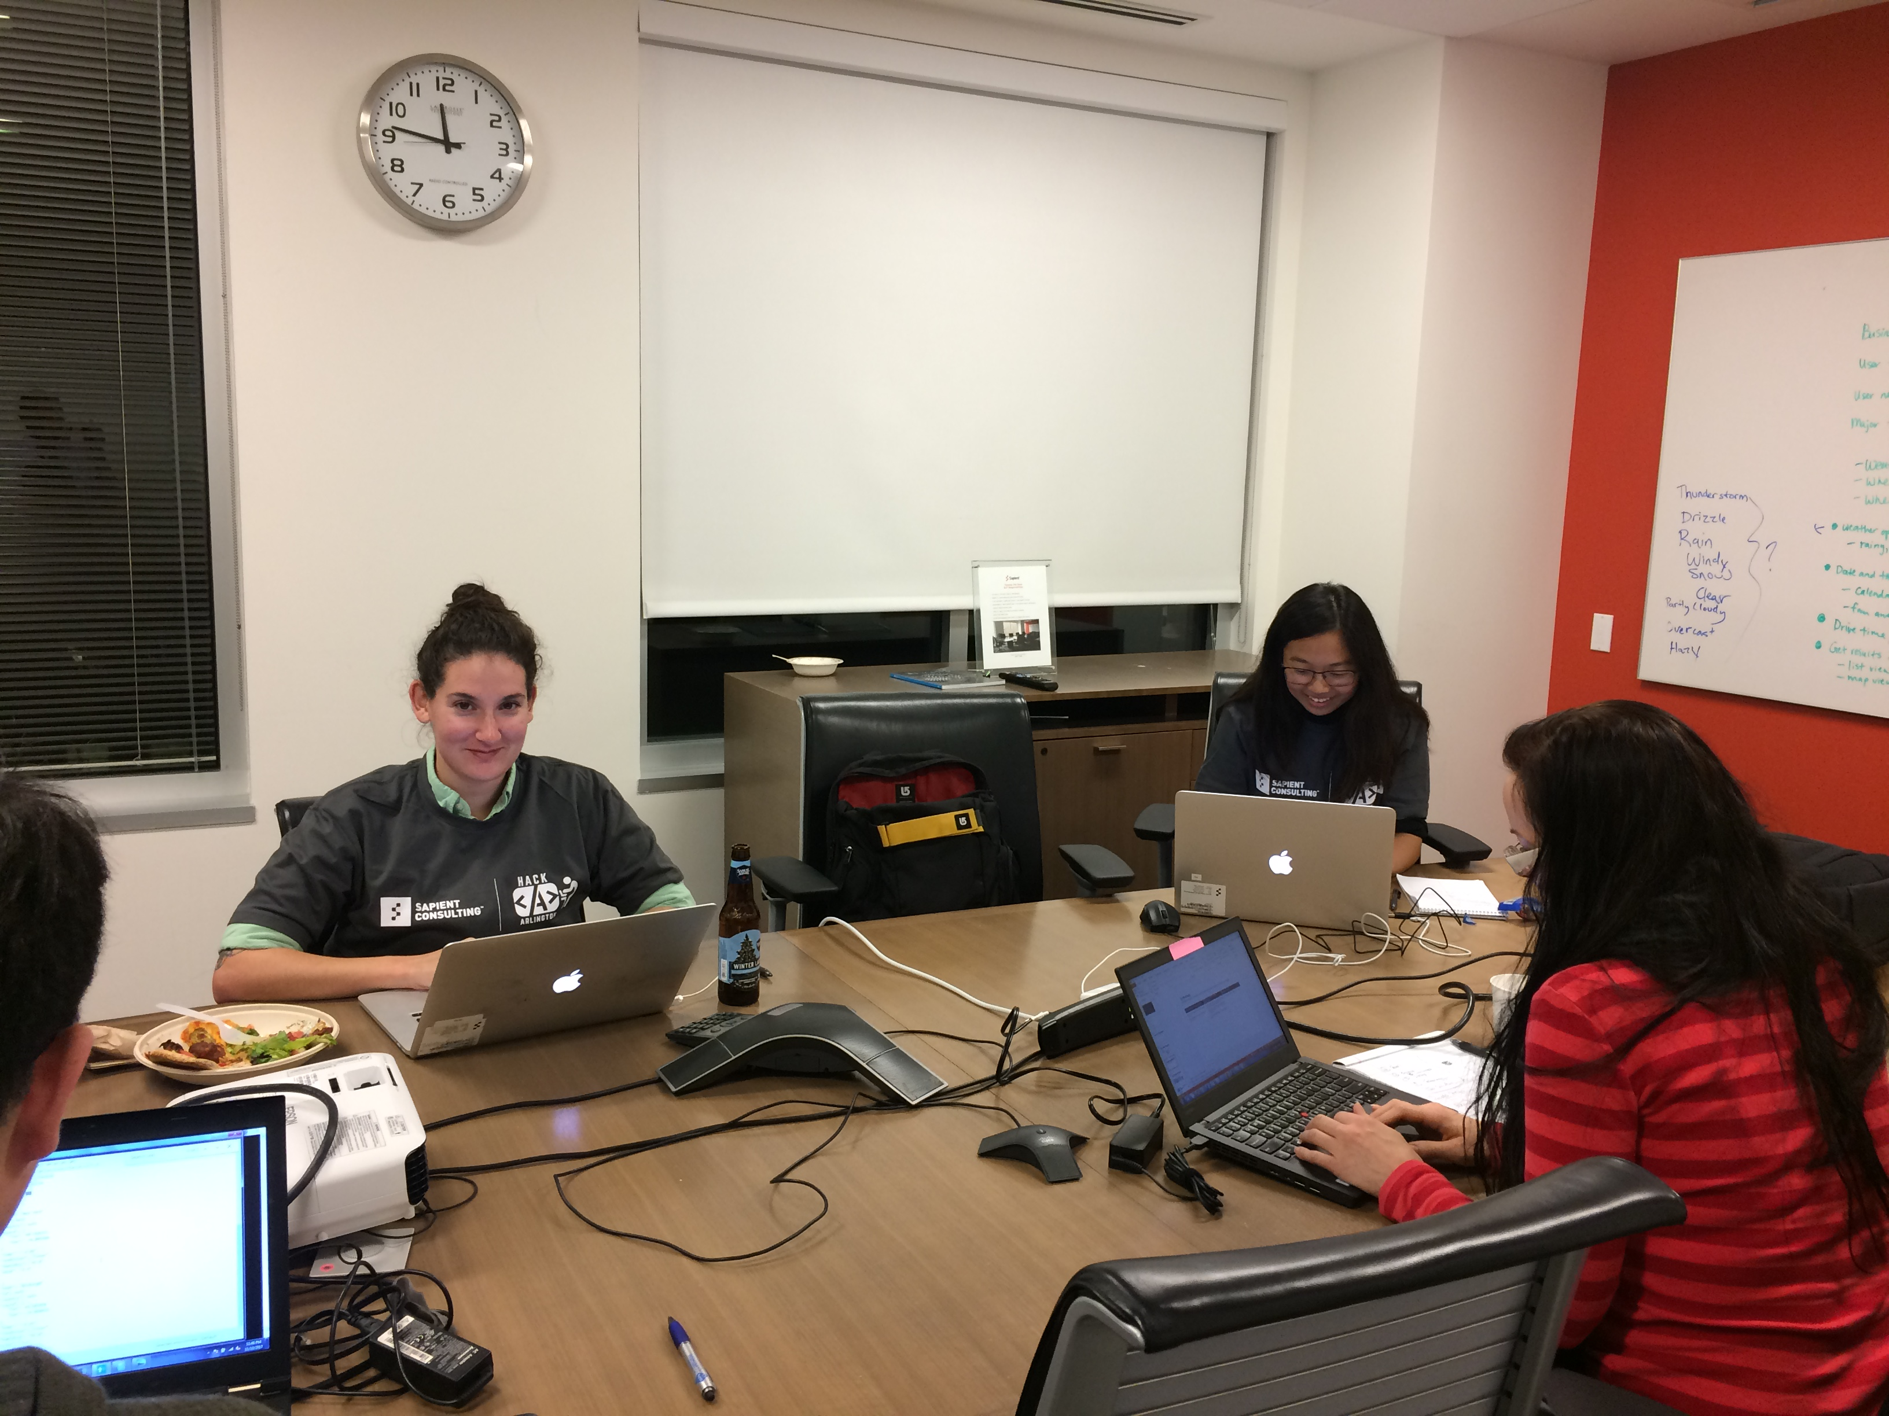
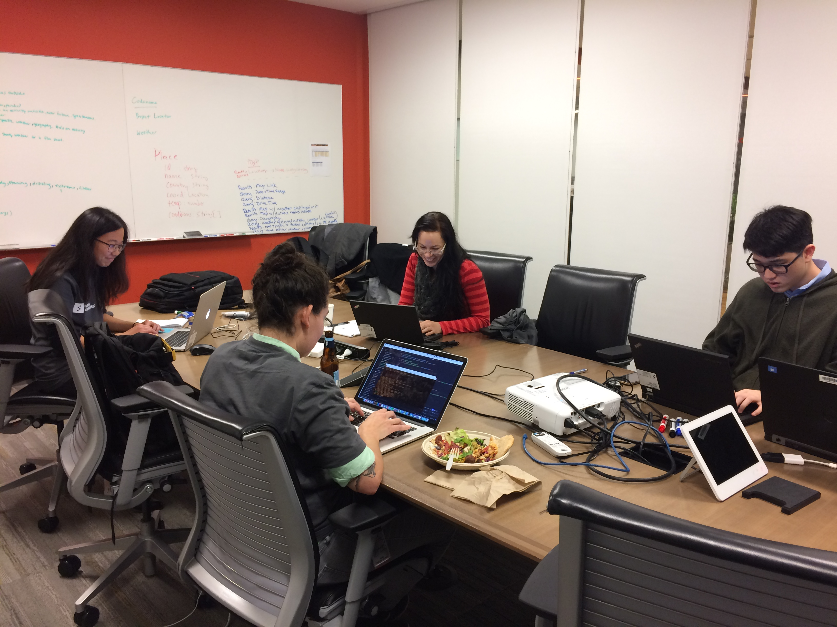
Team
Who was part of the team? How did they contribute to the solution?
Assign One leader and hold that person accountable
Bring in experienced teams
Sarah Goldman
Connor Cheong: Back-End Development
Xilu Fang: UX Design
Sarah Goldman: Front-End Development
Kolleen Jennings: Business Analysis
Notes:
Assign
Decision maker
Bring
Experienced people

Slide 4
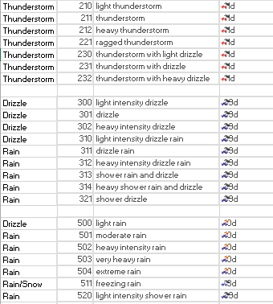
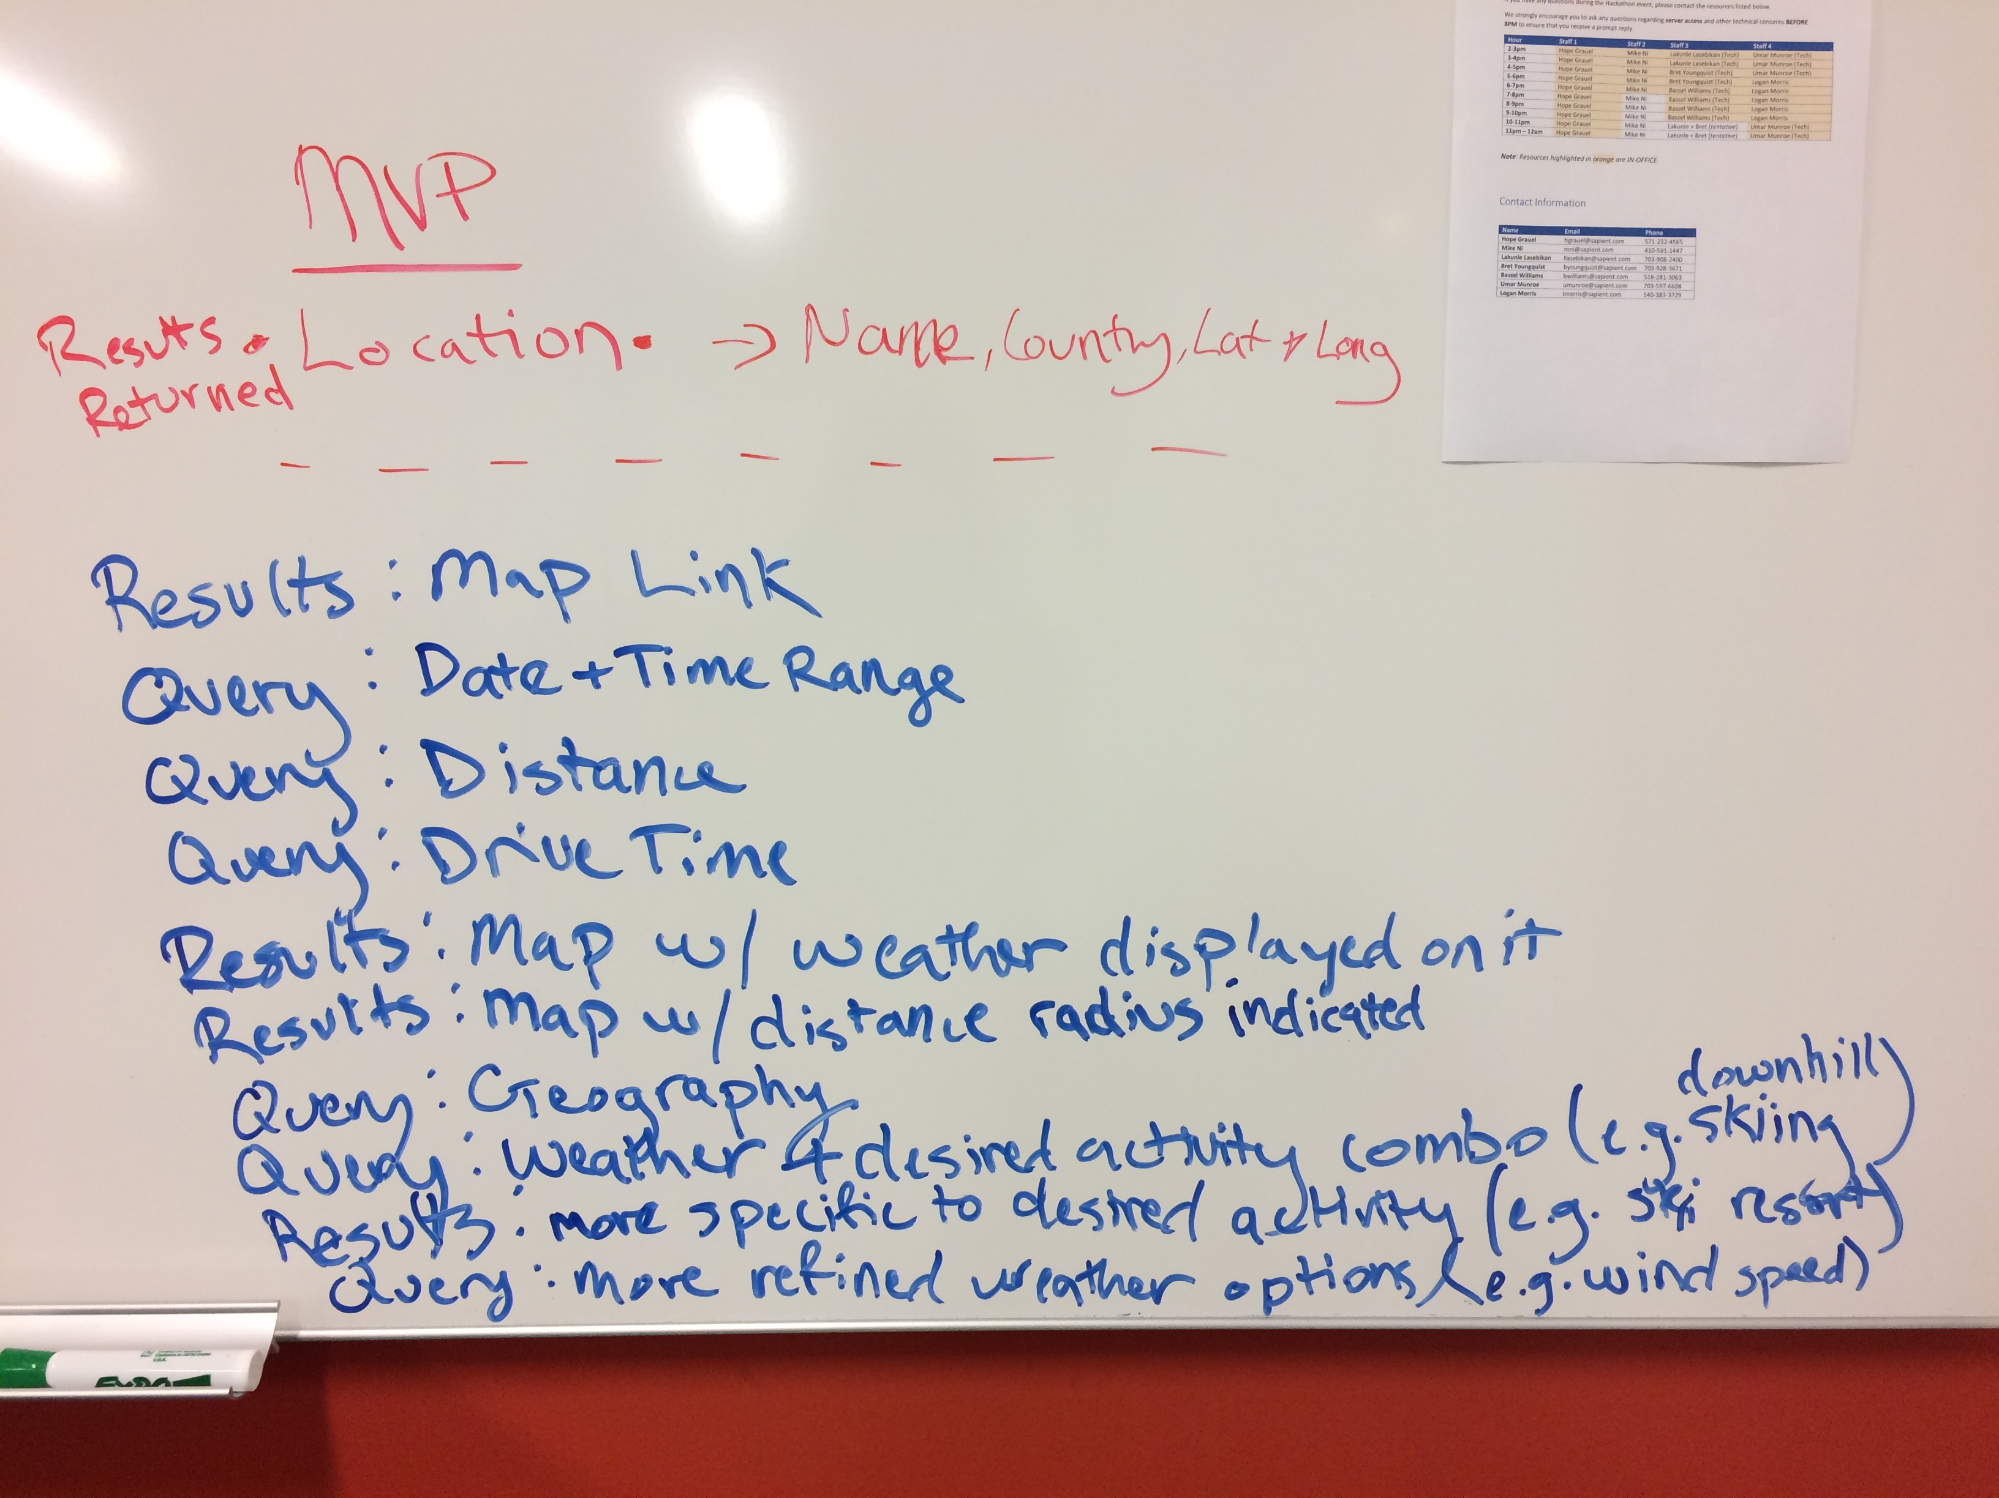
Process
What was your end-to-end process for planning, designing, building, deploying, and testing your solution?
Build the service using agile and iterative practices
MVP to deliver initial service by midnight deadline
Feature backlog
Individuals building the service communicated closely
Small and focused delivery team
Specifications & Design
Presentation
Test
Planning
Front- and Back-End Development
Test
Deploy
Notes:
Brainstorm ideas as a group
Design and requirements -> UX Design and Business Analysis
Building -> Front- and Back-End Developers work together
Deploying ->
Testing ->

Slide 5

Technology
What technologies (including infrastructure) did you use to build your solution and why?
Choose a modern technology stack
Default to open
What is your development stack and why did you choose it?
Which databases are you using and why did you choose them?
What datasets are made available to the public?

Slide 6
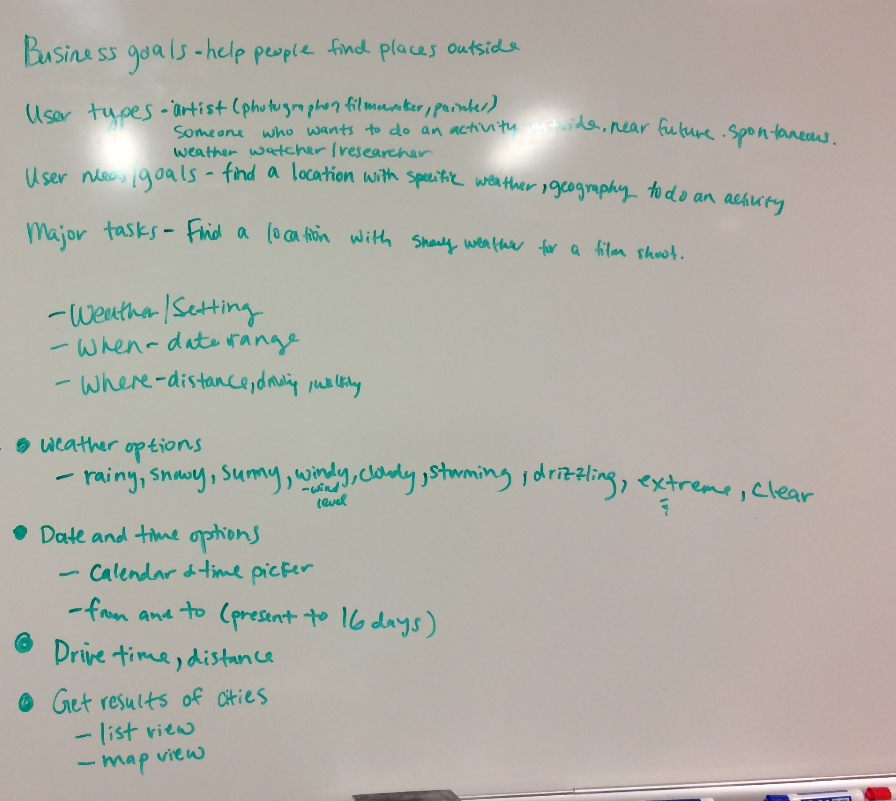
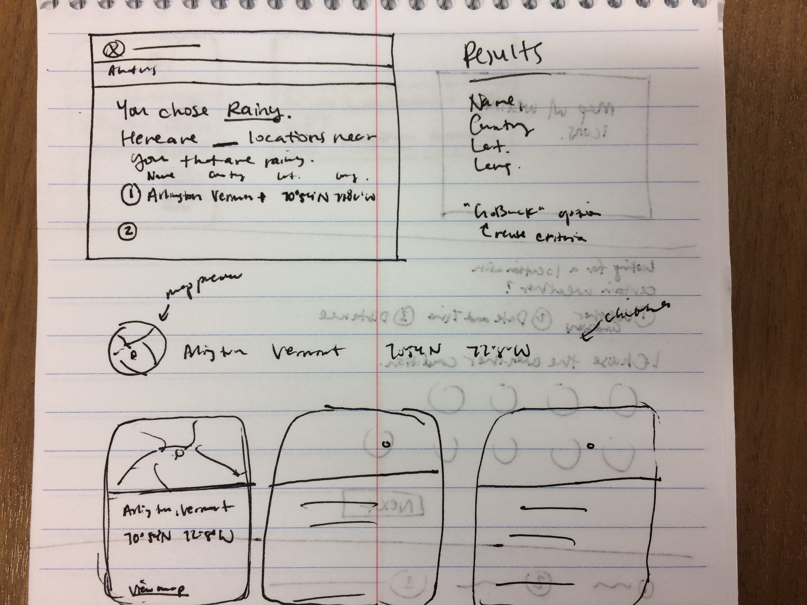
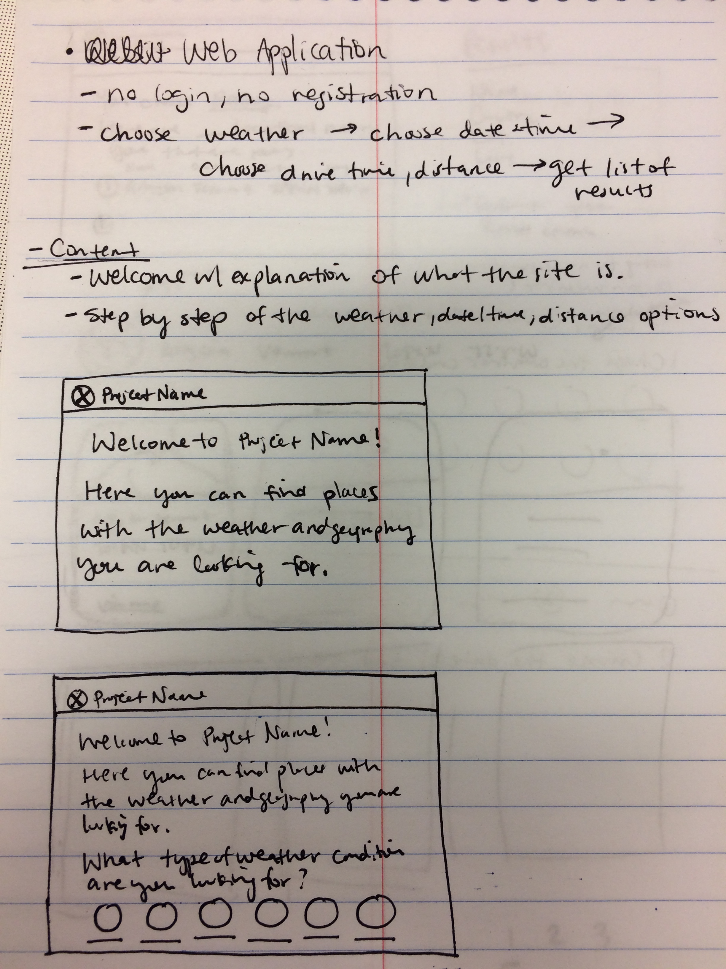
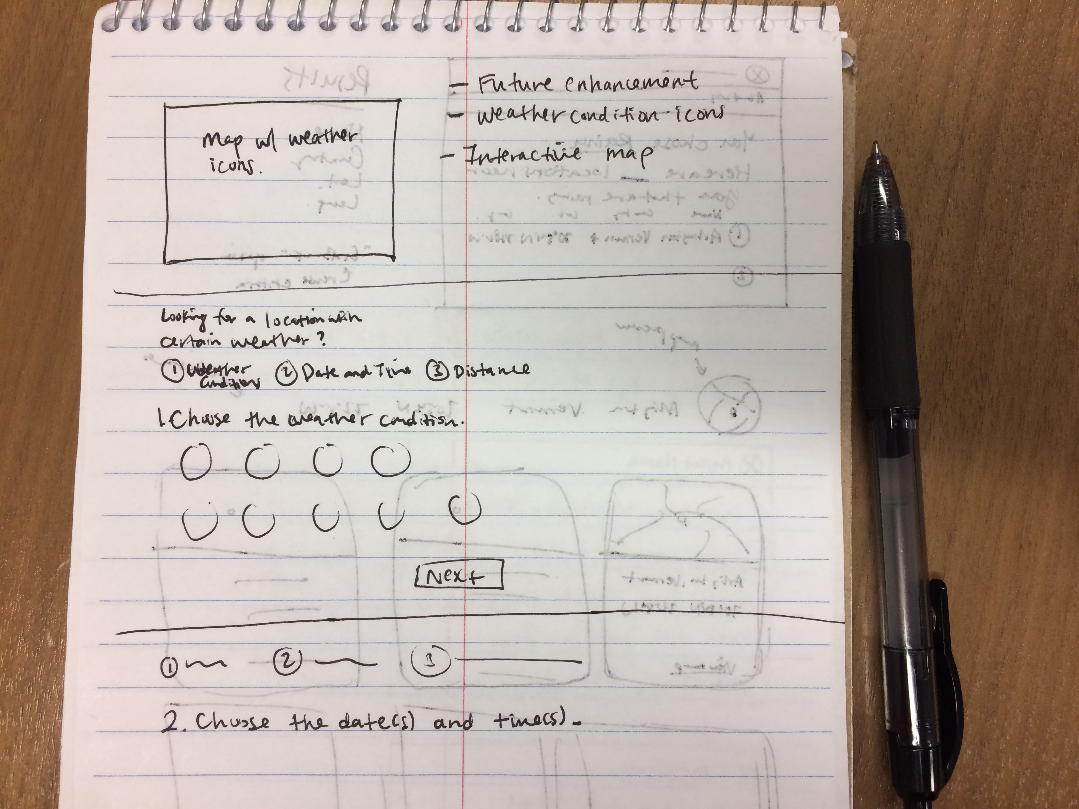
Design
What does the user interface look like? What are the key features? How did you address requirements (API, mobile accessible)?
Understand what people need
Address the whole experience, from start to finish
Make it simple and intuitive
Who are the primary users?
What user needs does the service address?
Why does the user want or need this service?
How do people currently accomplish the task the service is designed to help?
What are the current pain points with pre-service process?
Where does this service fit in the existing process?
What metrics will best indicate how well the service is working for its users?
What primary tasks are users trying to accomplish?
Is the language in this service plain and universal?
Notes:
Understand
Who are your primary users?
What user needs will this service address?
Why does the user want or need this service?
Address
What are the different ways (both online and offline) that people currently accomplish the task the digital service is designed to help with?
Where are user pain points in the current way people accomplish the task?
Where does this specific project fit into the larger way people currently obtain the service being offered?
What metrics will best indicate how well the service is working for its users?
Make
What primary tasks are the user trying to accomplish?
Is the language as plain and universal as possible?

Slide 7
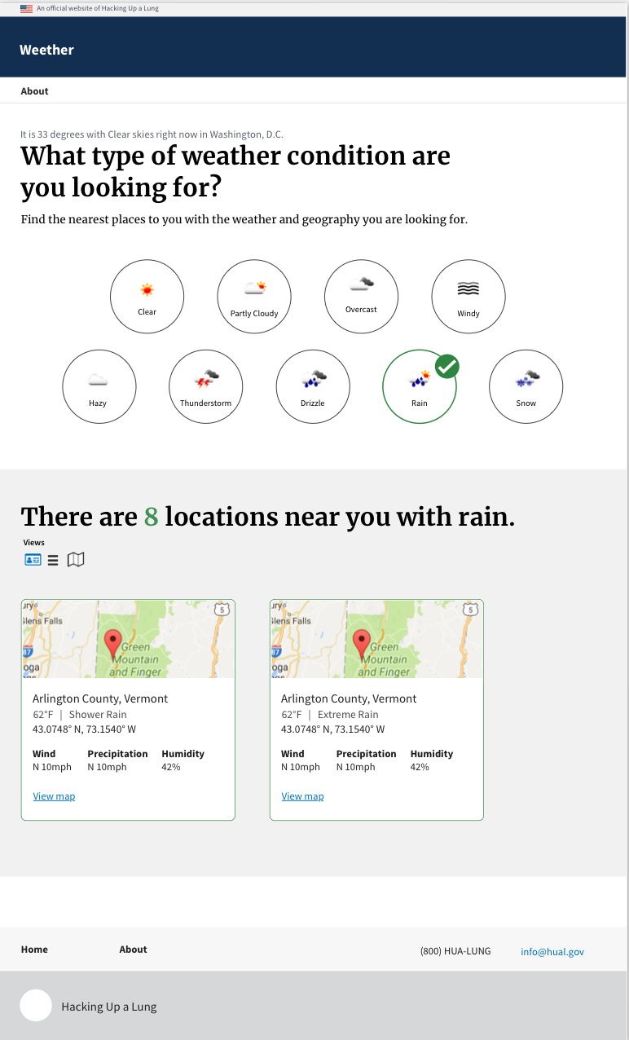
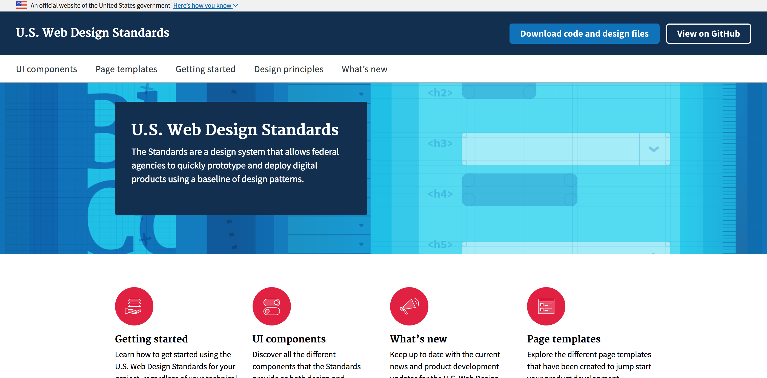
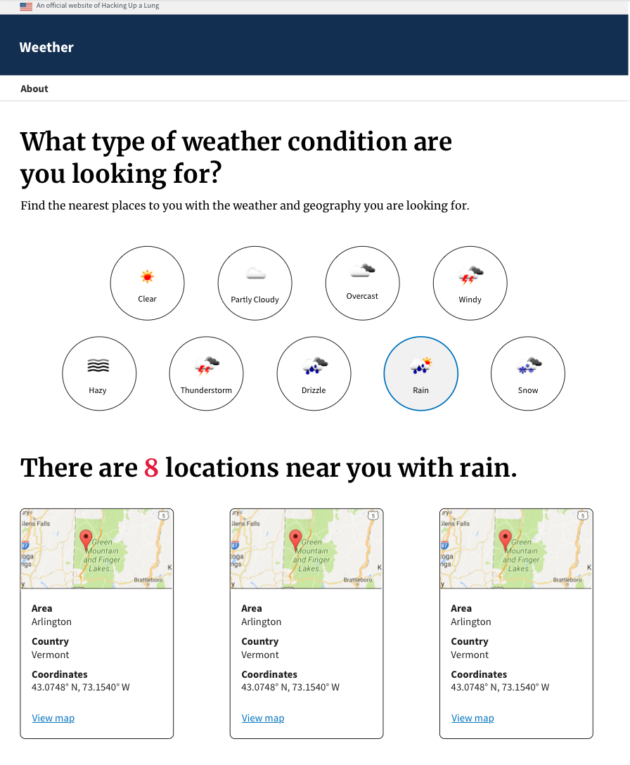
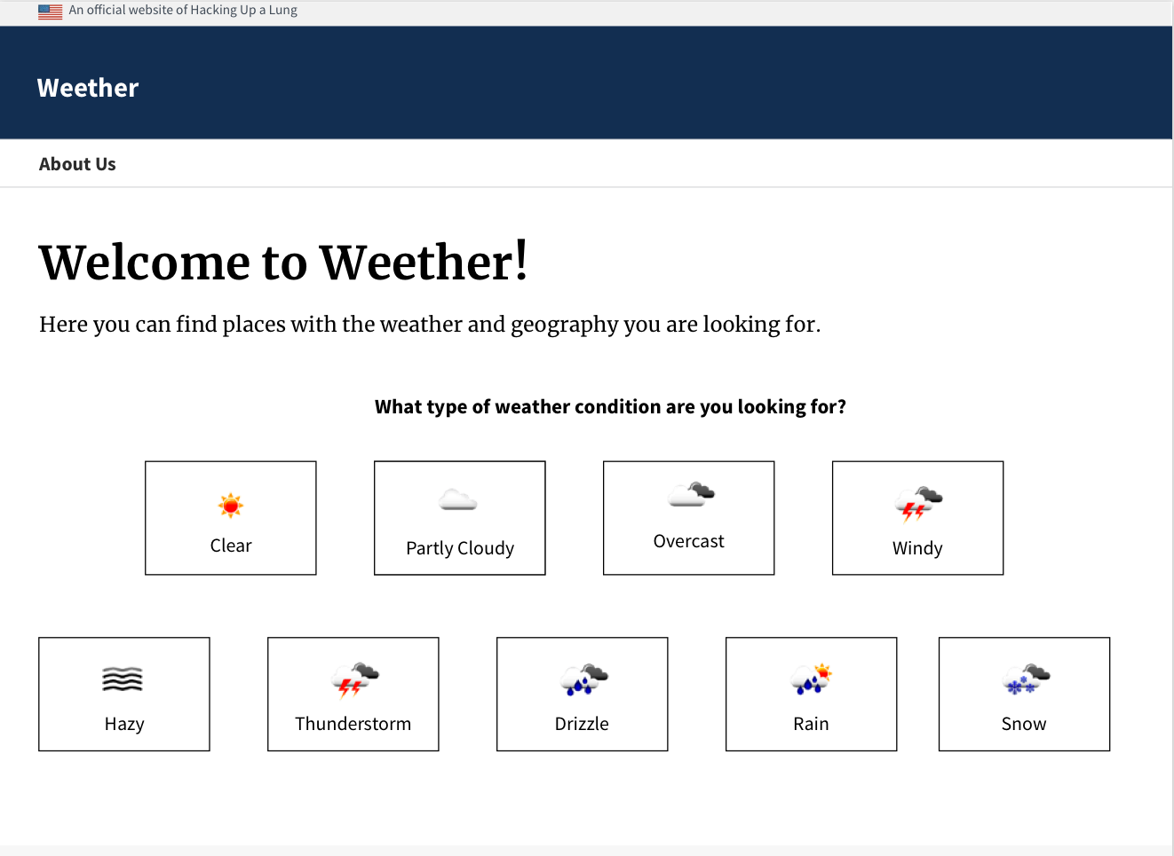
Design
Notes:
Understand
Who are your primary users?
What user needs will this service address?
Why does the user want or need this service?
Address
What are the different ways (both online and offline) that people currently accomplish the task the digital service is designed to help with?
Where are user pain points in the current way people accomplish the task?
Where does this specific project fit into the larger way people currently obtain the service being offered?
What metrics will best indicate how well the service is working for its users?
Make
What primary tasks are the user trying to accomplish?
Is the language as plain and universal as possible?

Slide 8

Challenges
What challenges did the team face? What obstacles did you overcome?
Setting up the environment
Limited search from current location
Choosing an idea in the beginning
Limited research
Time

Slide 9
Solution
Demonstration: What does the solution do? How does it work? What’s the impact?
Weether helps users find locations to enjoy the weather and activities they love.
How does Weether work?
What is Weether’s impact?
Weether

Slide 10
Thank you

